Slide 1

ECE 231 Electrical Circuits and Systems
HQ U.S. Air Force Academy
Maj Kevin Walchko, PhD

Slide 2
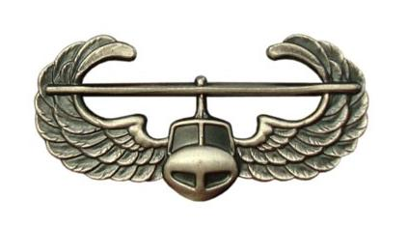



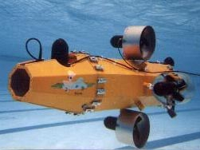



Background – Pre-AF

Slide 3
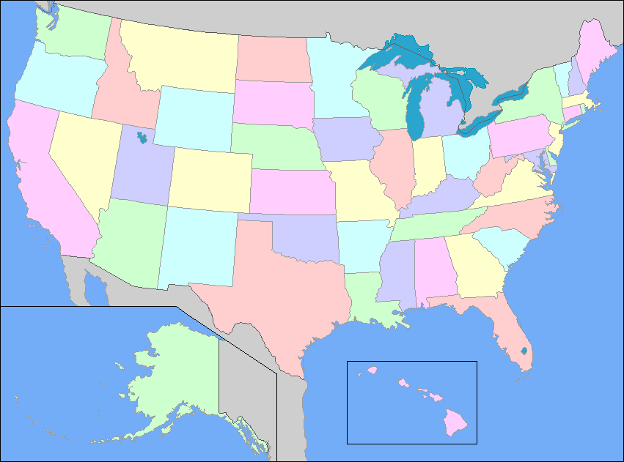
AF Carrier So Far
NRO
Chantilly, VA
CW/DF
USAFA
Space Superiority
LAAFB
AFRL Space Vehicles
Kirtland AFB

Slide 4
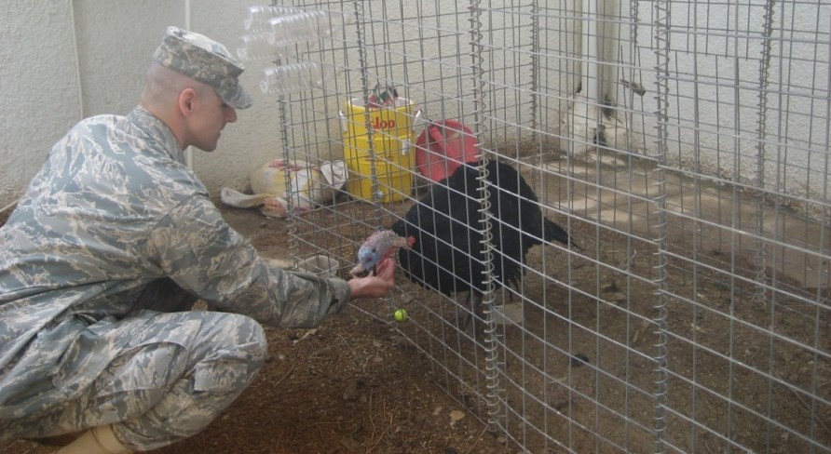
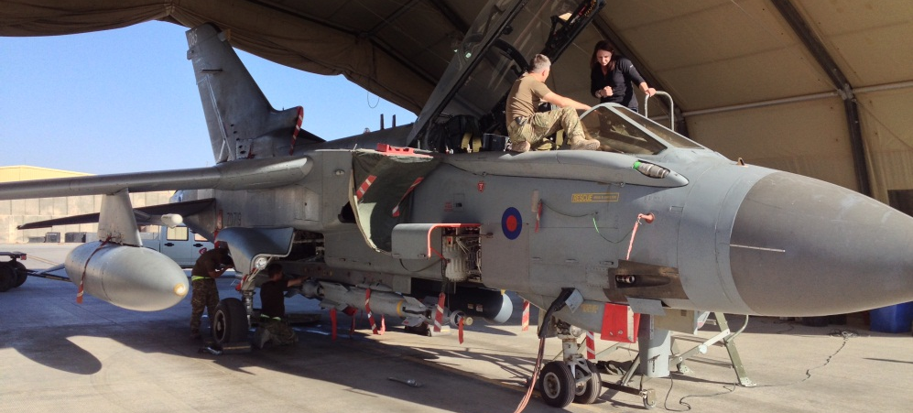
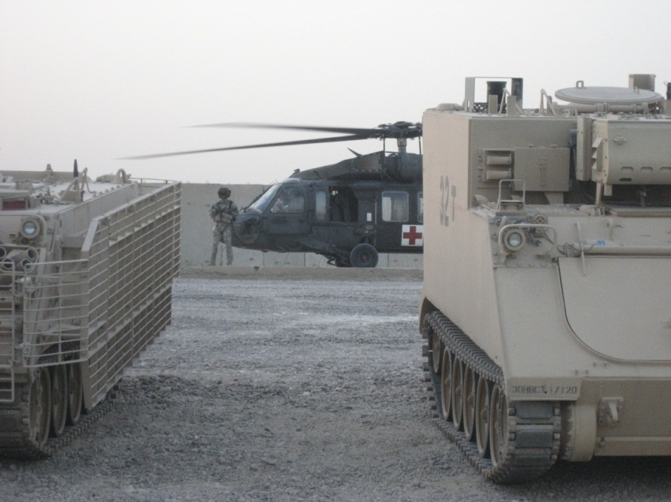
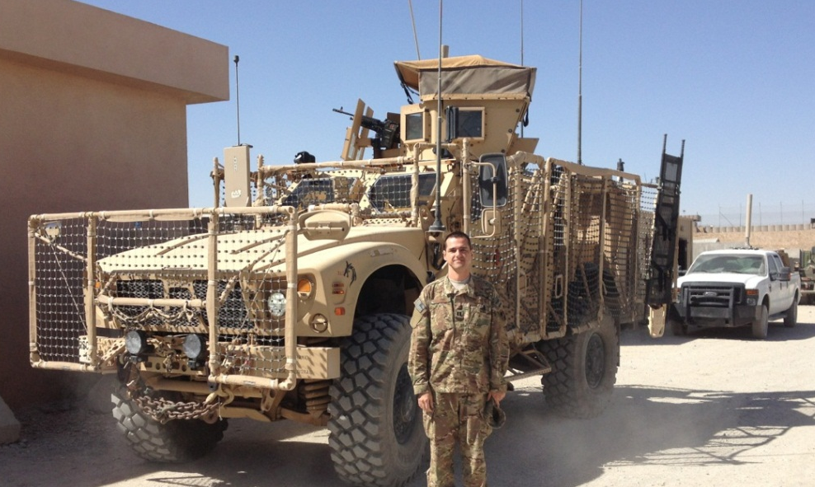



Deployments
Iraq Feb – Aug 09
Afghanistan Sept 13 – Feb 14
DCMA Southern Iraq: LOGCAP
ISAF IJC CJ2: NRO LNO

Slide 5
Roll call & Who are you?
Name
Where are you from?
What is your major?
Desired AFSC?
Why did you join the military?
What fills your time (outside of academics)?
Notes:
Fill out seating chart

Slide 6
Course
SharePoint: https://sharepoint.usafa.edu/academics/eleccompengineering/ece231/default.aspx
Textbook:
The Analysis and Design of Linear Circuits, 8th Ed.
Textbook homework
self graded w/ coversheet
This class uses Matlab … see admin folder
Supplemental readings (later in class) online
The only way to do well in the class is to work problems!!

Slide 7
Expectations
Read and be familiar with course materials (e.g., syllabus, readings, etc)
To be successful, you MUST work problems
Read the day’s materials before the class
I will not cover every detail
No surfing the internet/texting/etc during class
Be on time
Be professional
Ask questions during class and stay engaged
If you need to miss class due to an SCA, please let me know as soon as you do (ASAP)!
Take notes … I don’t give handouts!
Remember: This class is for you to learn, not for me to teach

Slide 8
Classroom ROEs
Coffee/water is ok (in approved containers); no food
UOD and honor rules
Attendance (it is your duty)
Participate… makes class more fun for us all
Bathroom Breaks… if you need to go, quickly and quietly excuse yourself

Slide 9
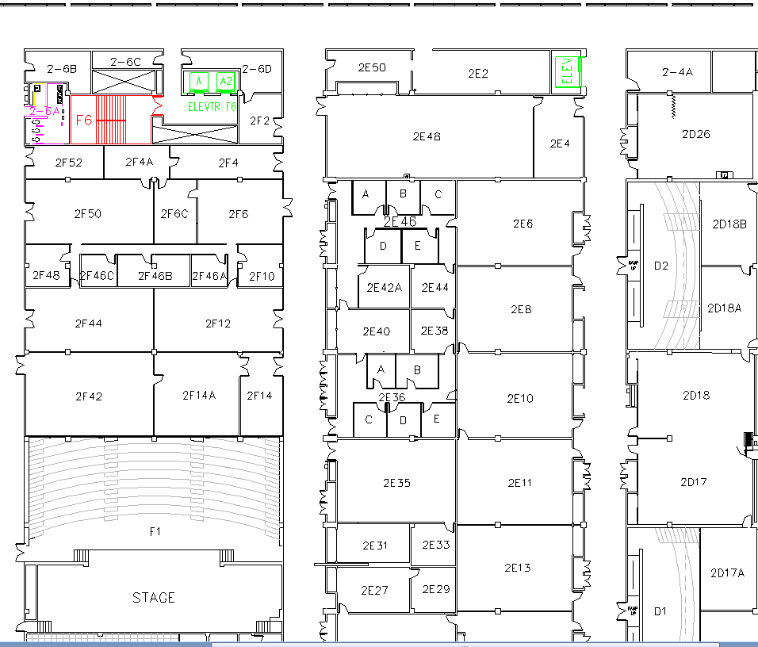
West (Terrazzo) Side
You are here

Slide 10
Extra Instruction (EI)
M1
T1
Office: 2F48
kevin.walchko@usafa.edu
My schedule is dynamic, so feel free to send me a meeting invite or email for EI
M2
T2
M3
T3
M4
T4
Available
M5
T5
Sometimes Available
M6
T6
Always Unavailable
M7
T7

Slide 11
Homework/Reading
Due next class: Block I skills review
Read the Ethics Handout

Slide 12
backups

